Slide 1
Analyze Data on list pages
Public preview
Business Central
2023 release wave 1

Slide 2
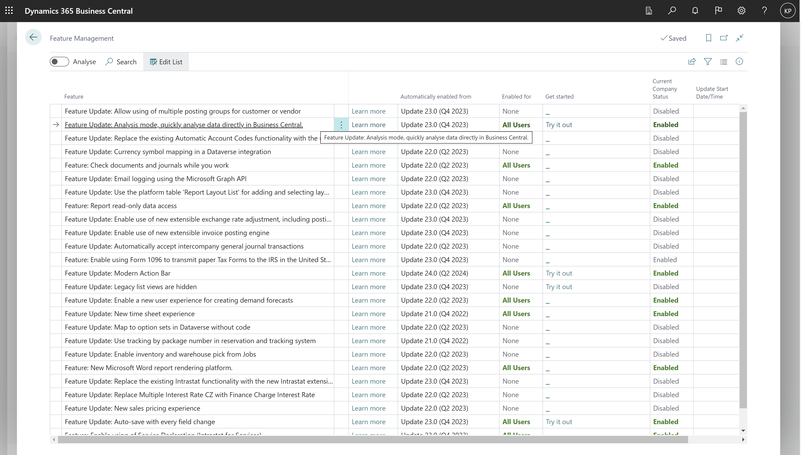
Enable under Feature Management

Slide 3
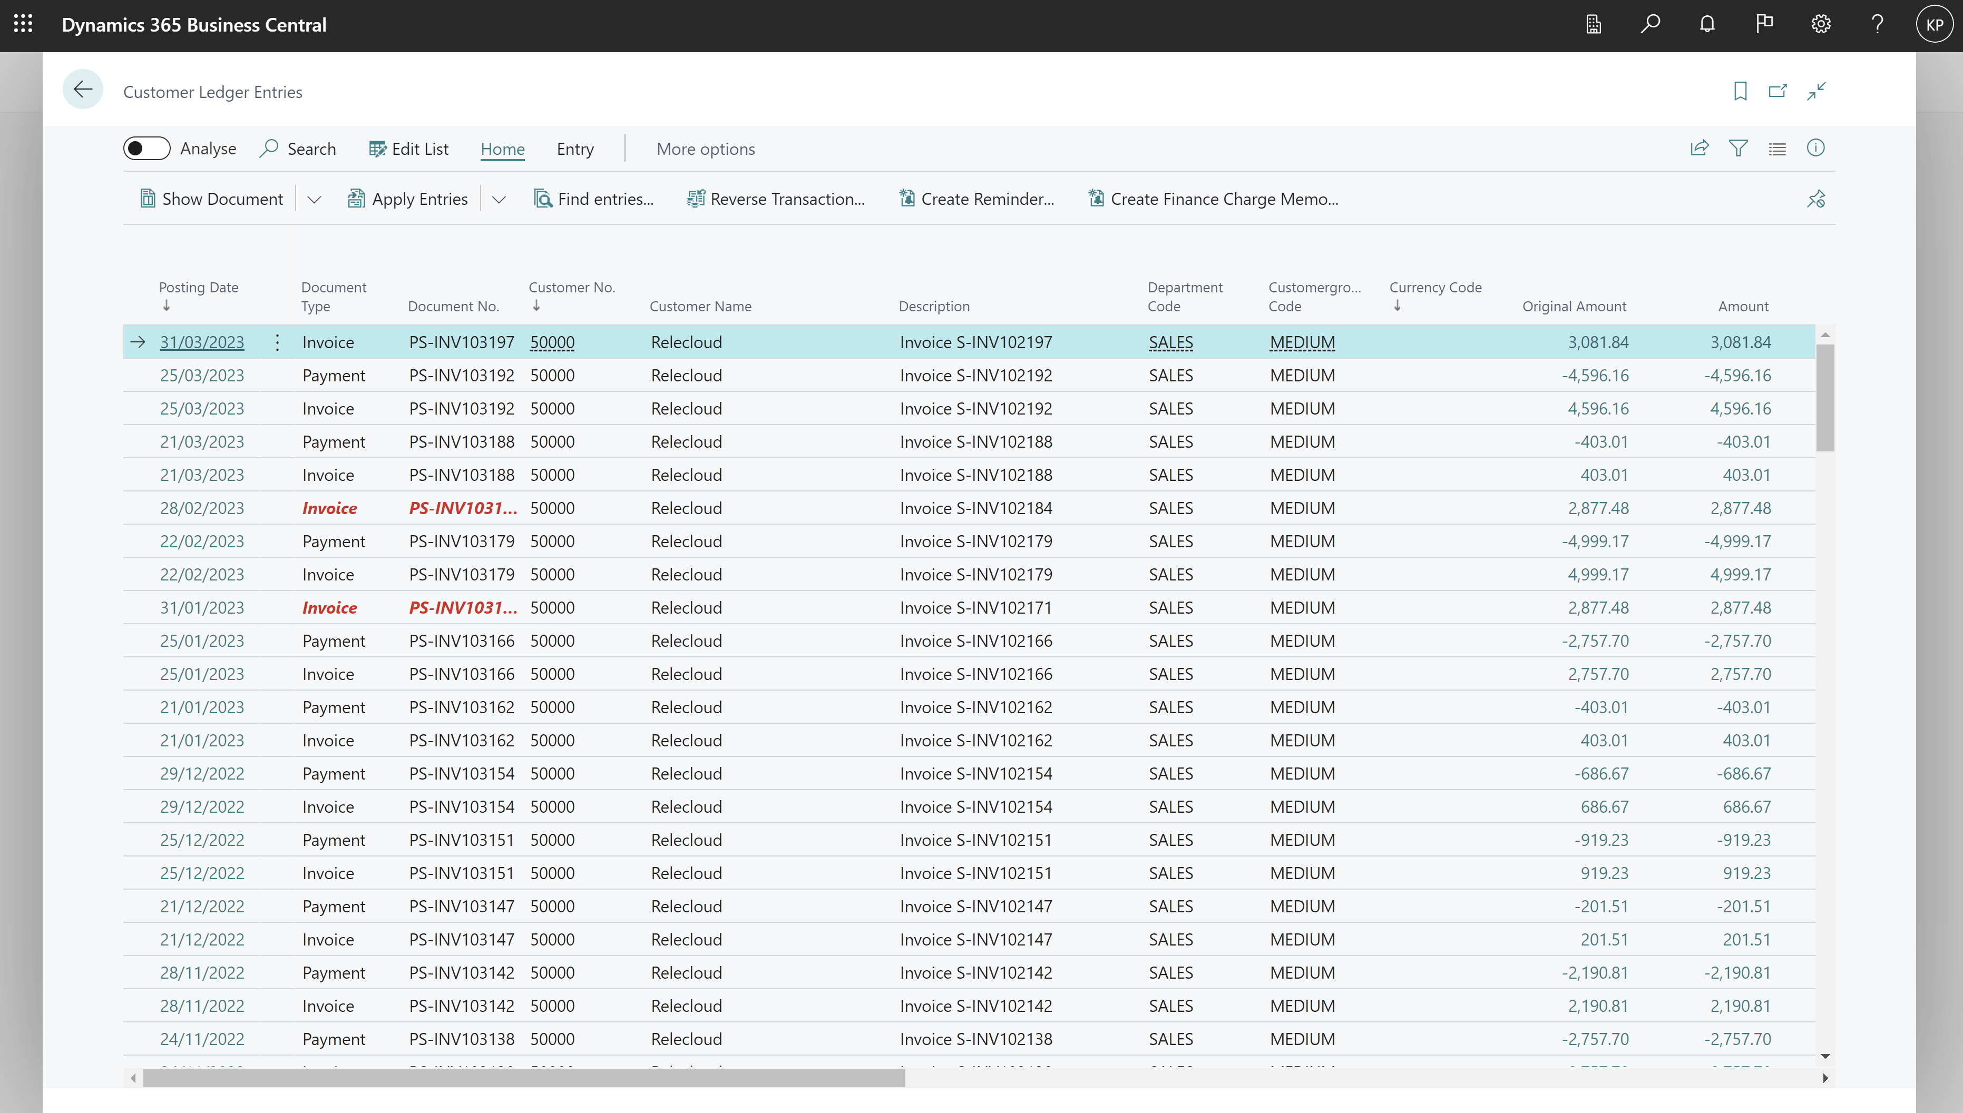
Go to Analysis Mode on a list page

Slide 4
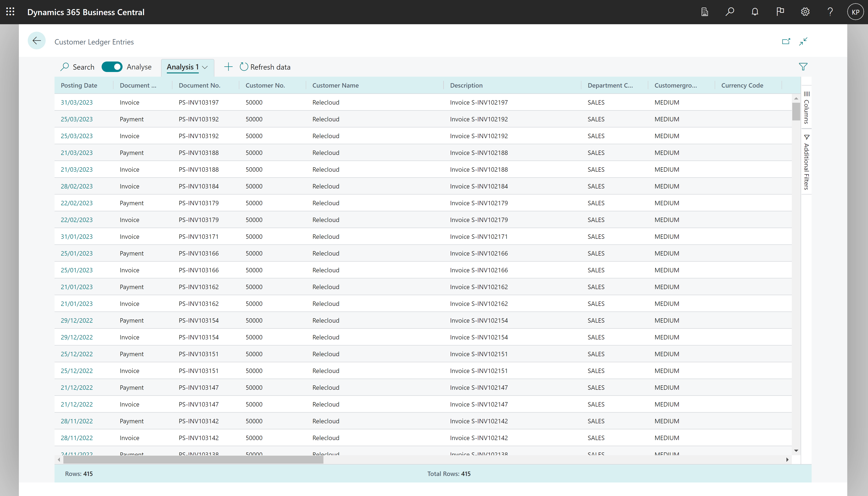
Opens the list with additional analysis capabilities

Slide 5
Page Areas in Analysis mode
Tabs pane
Field modifier area
Data area

Slide 6
Row count always shown on the bottom of the page

Slide 7
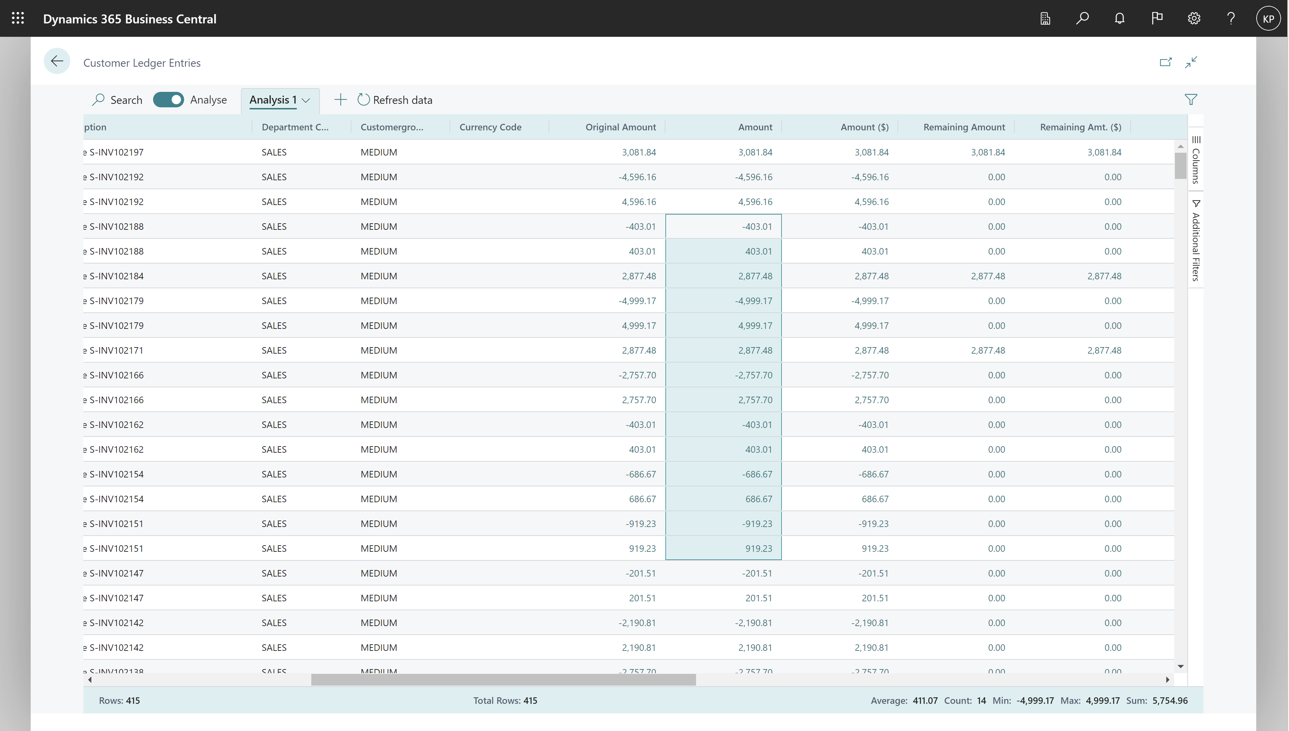
Mark cells for easy statistics

Slide 8
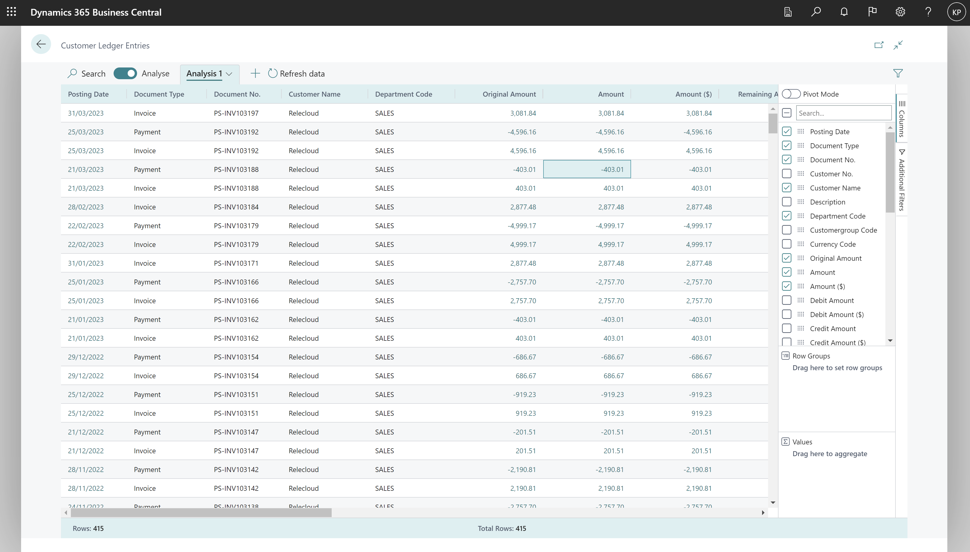
Choose which columns to show

Slide 9
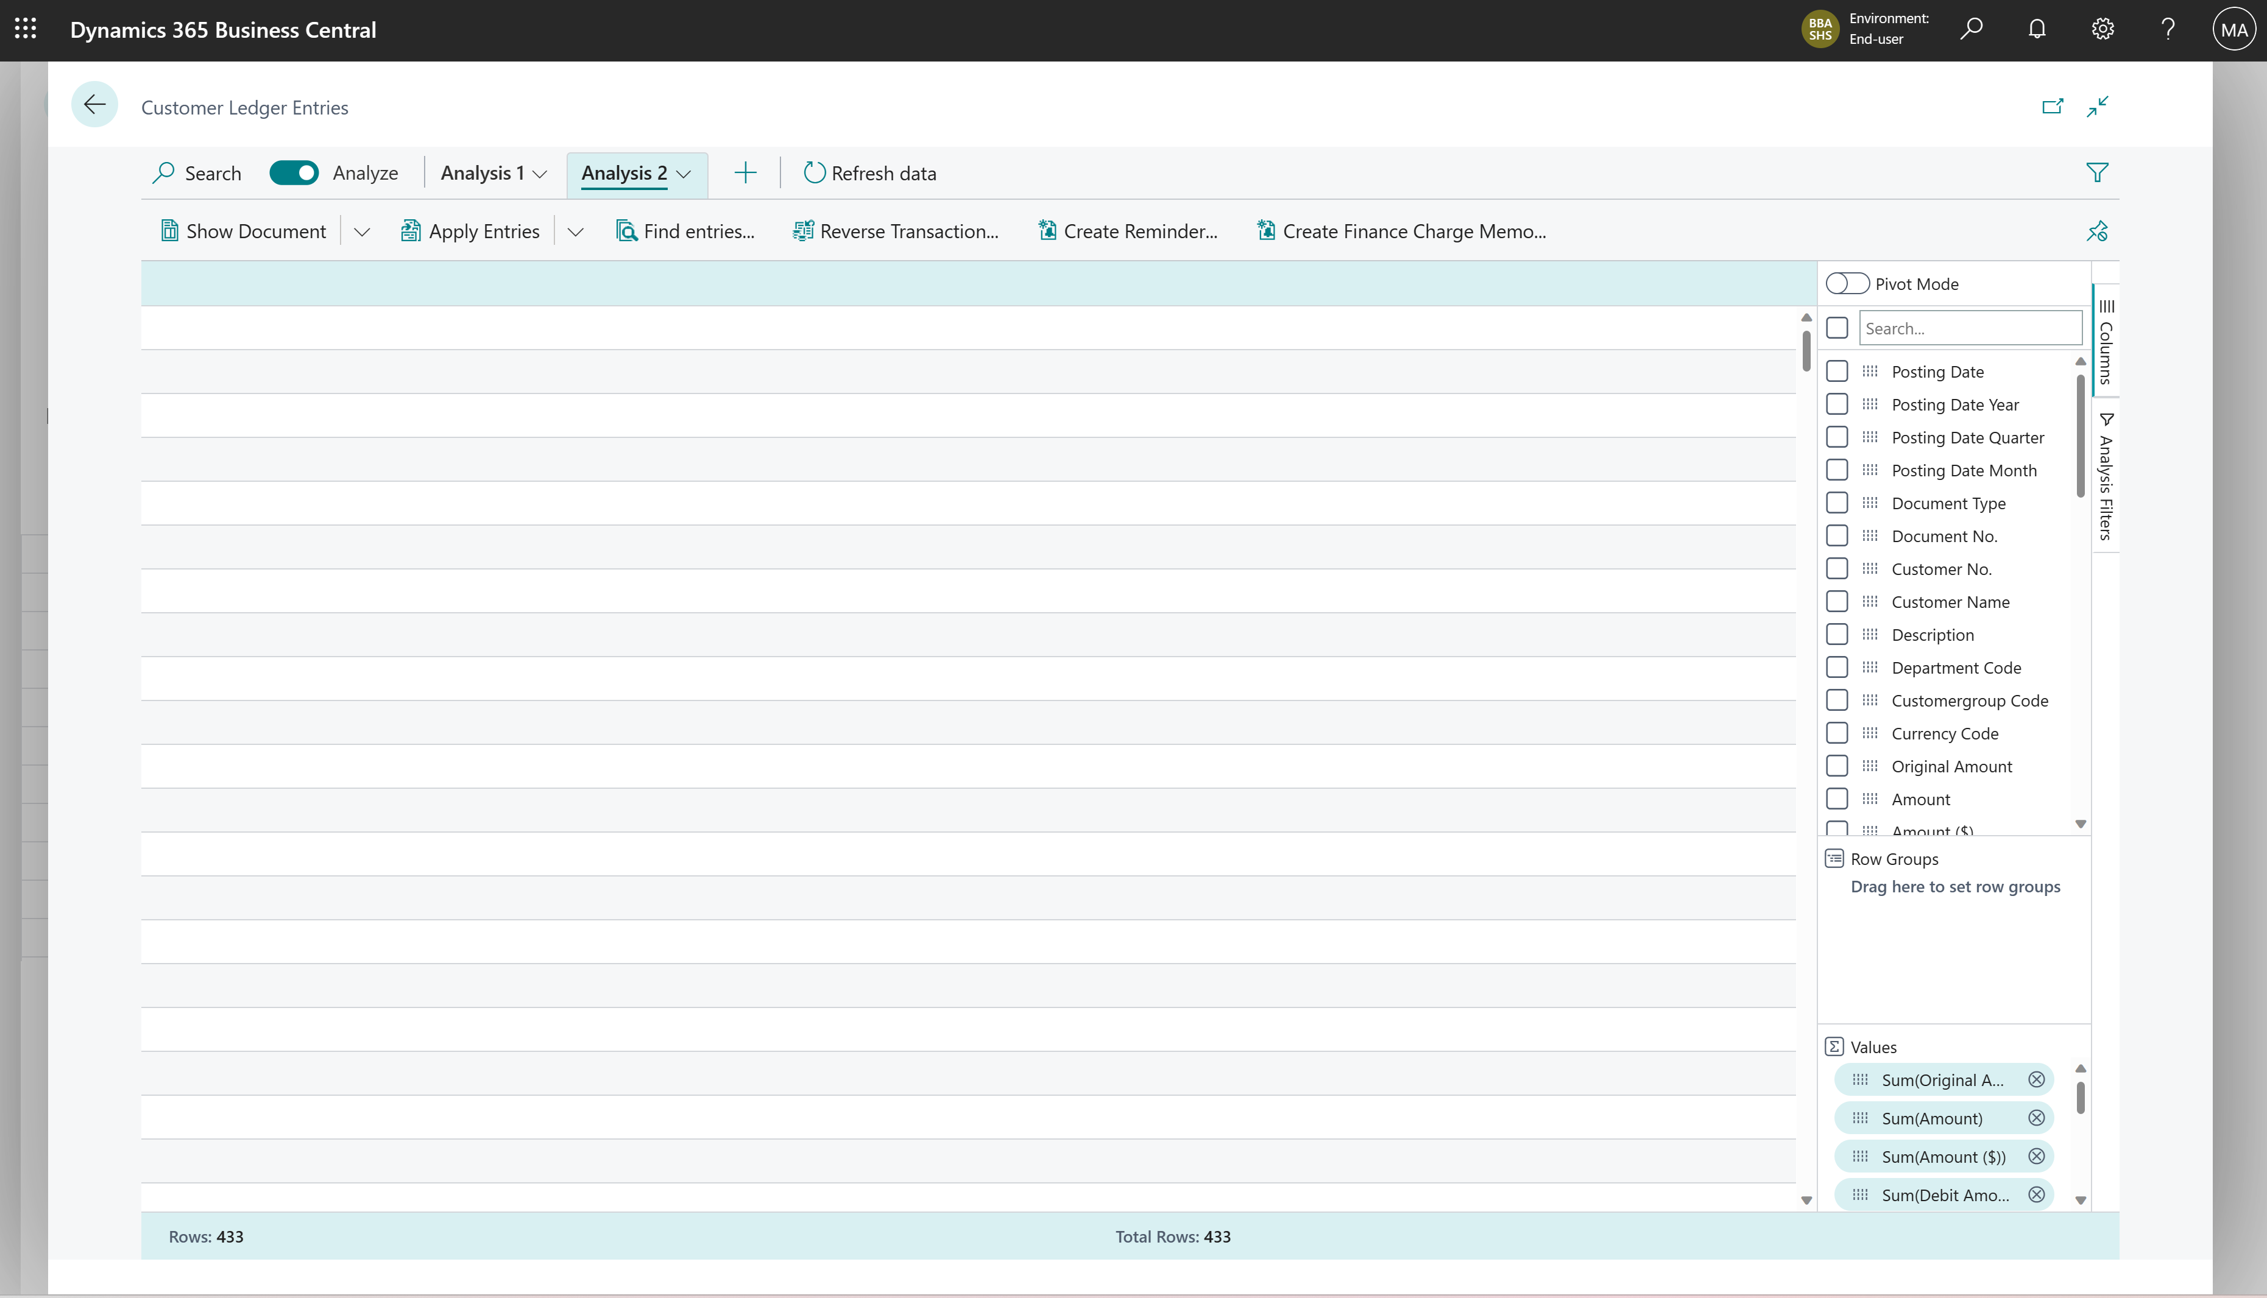
Clear all columns

Slide 10
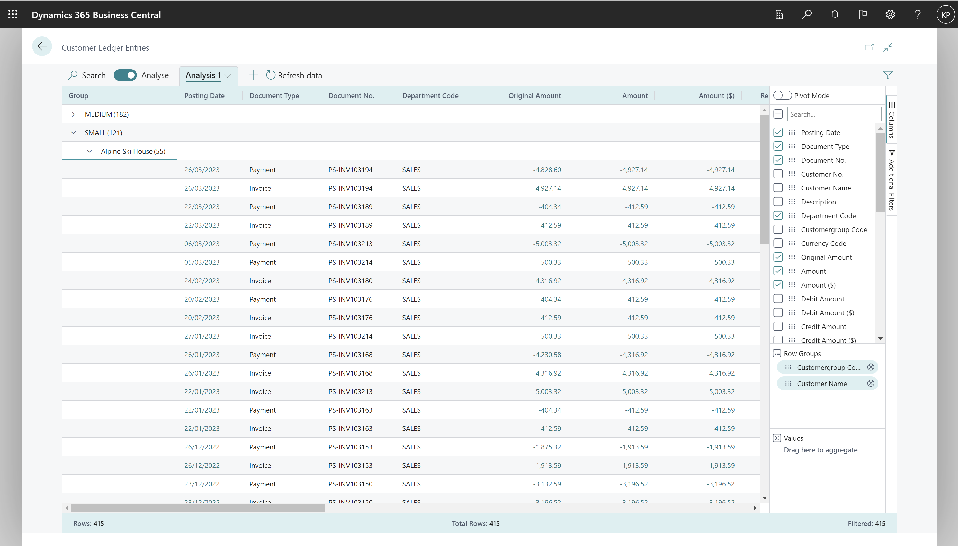
Group data by Row Groups

Slide 11
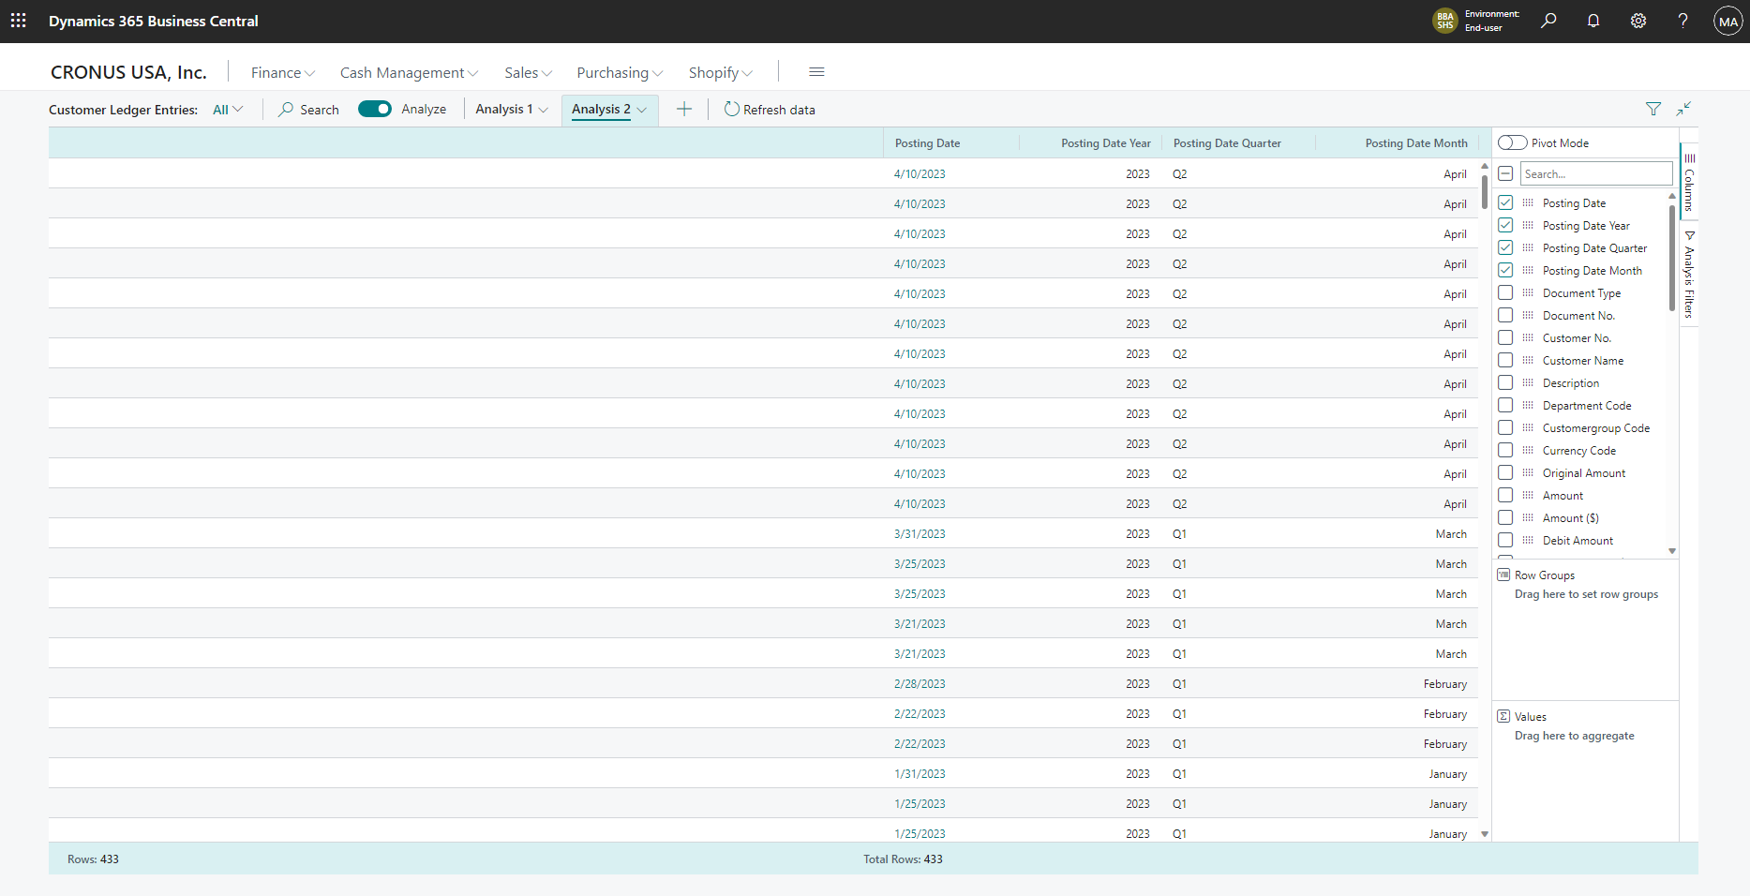
All date fields has a Year-Quarter-Month hierarchy

Slide 12
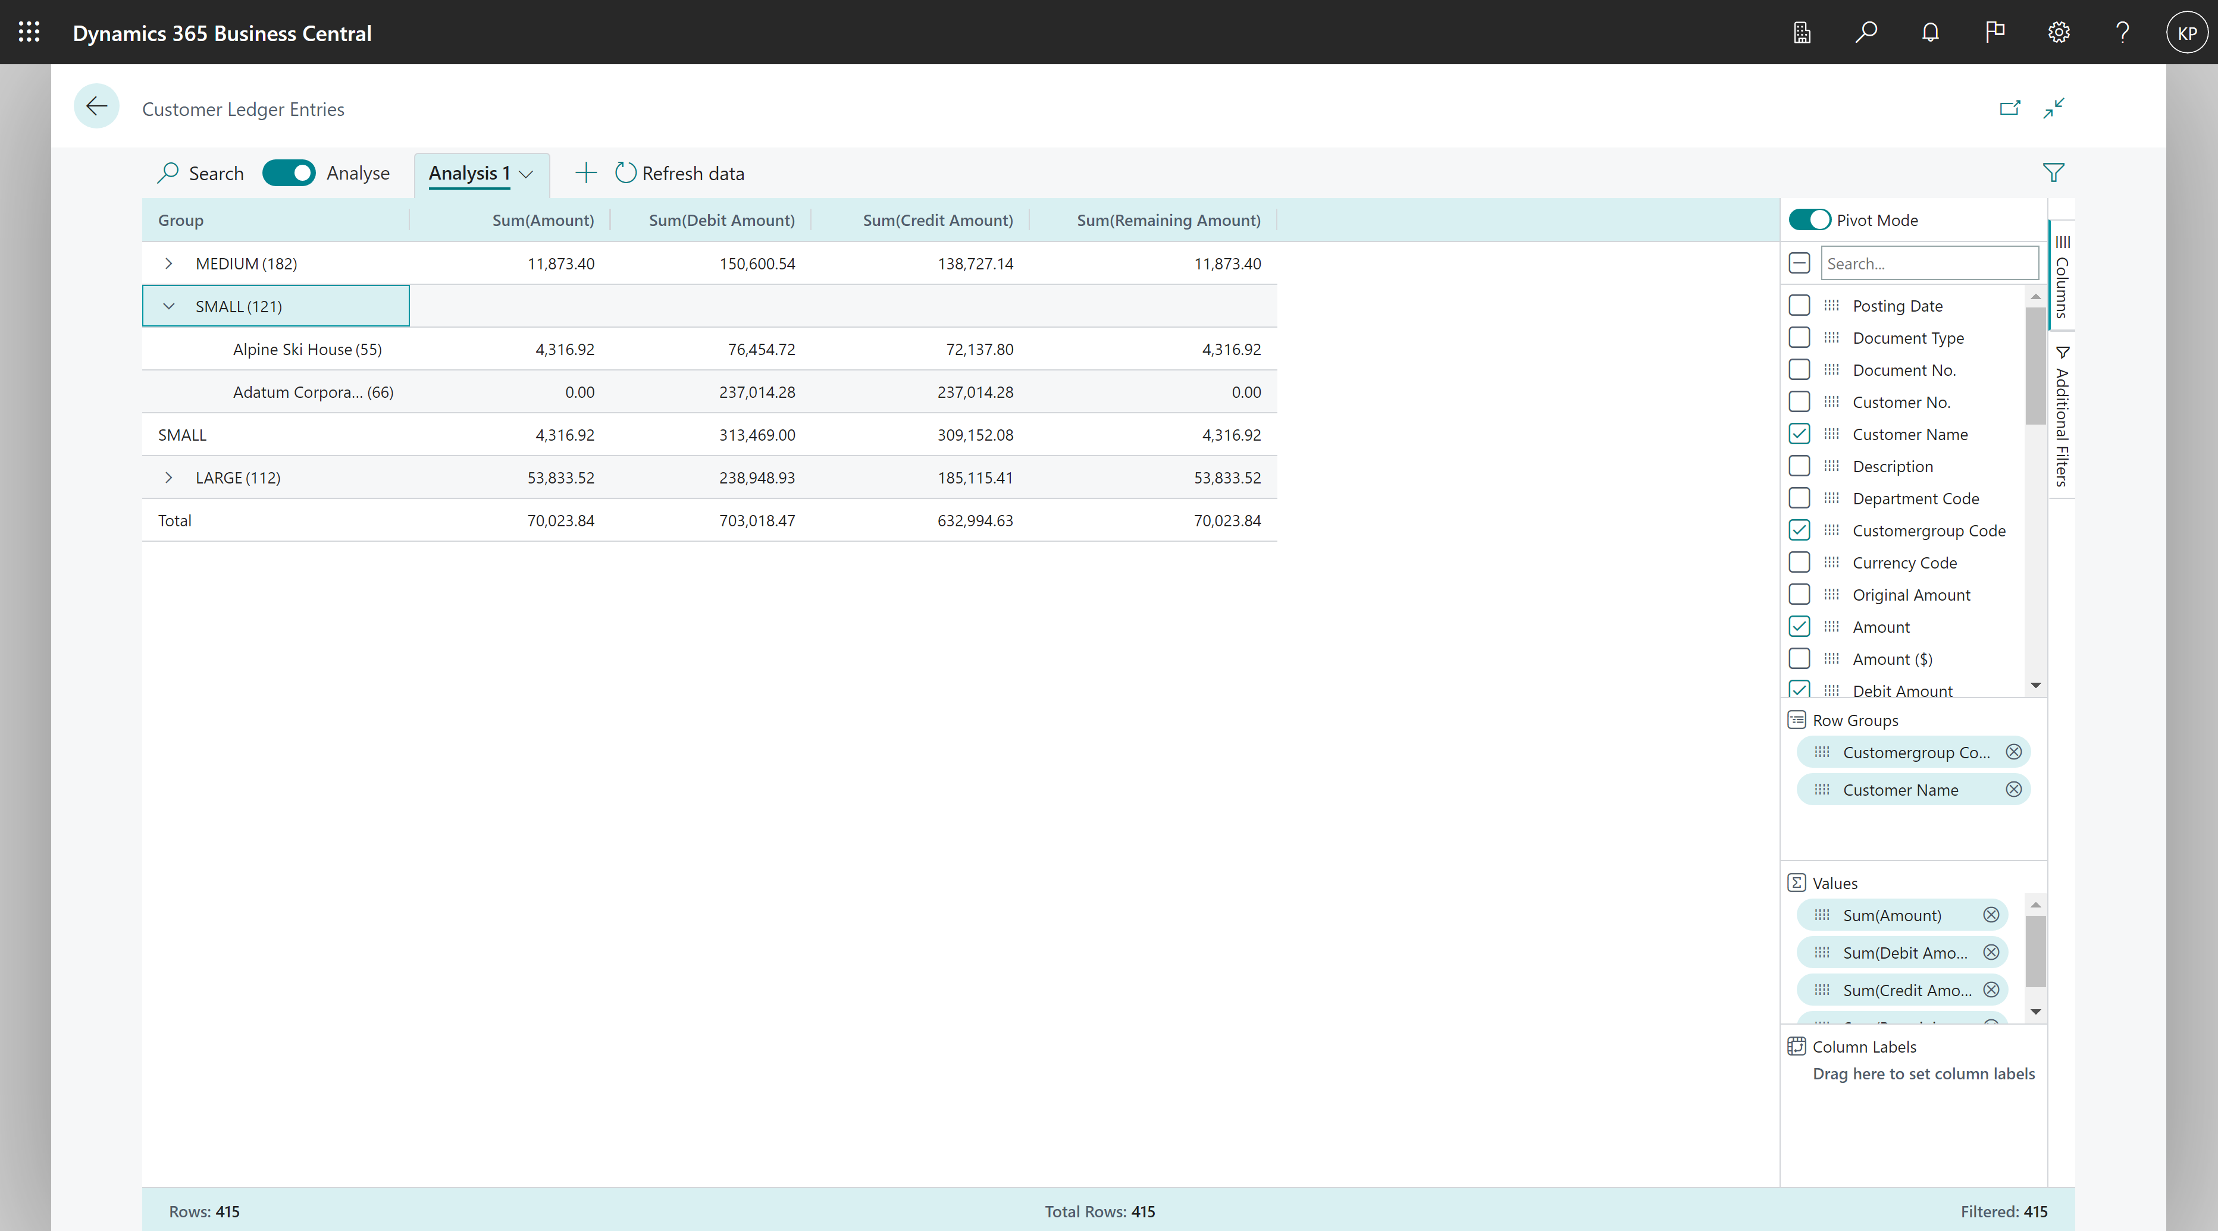
Pivot data by Row Groups

Slide 13
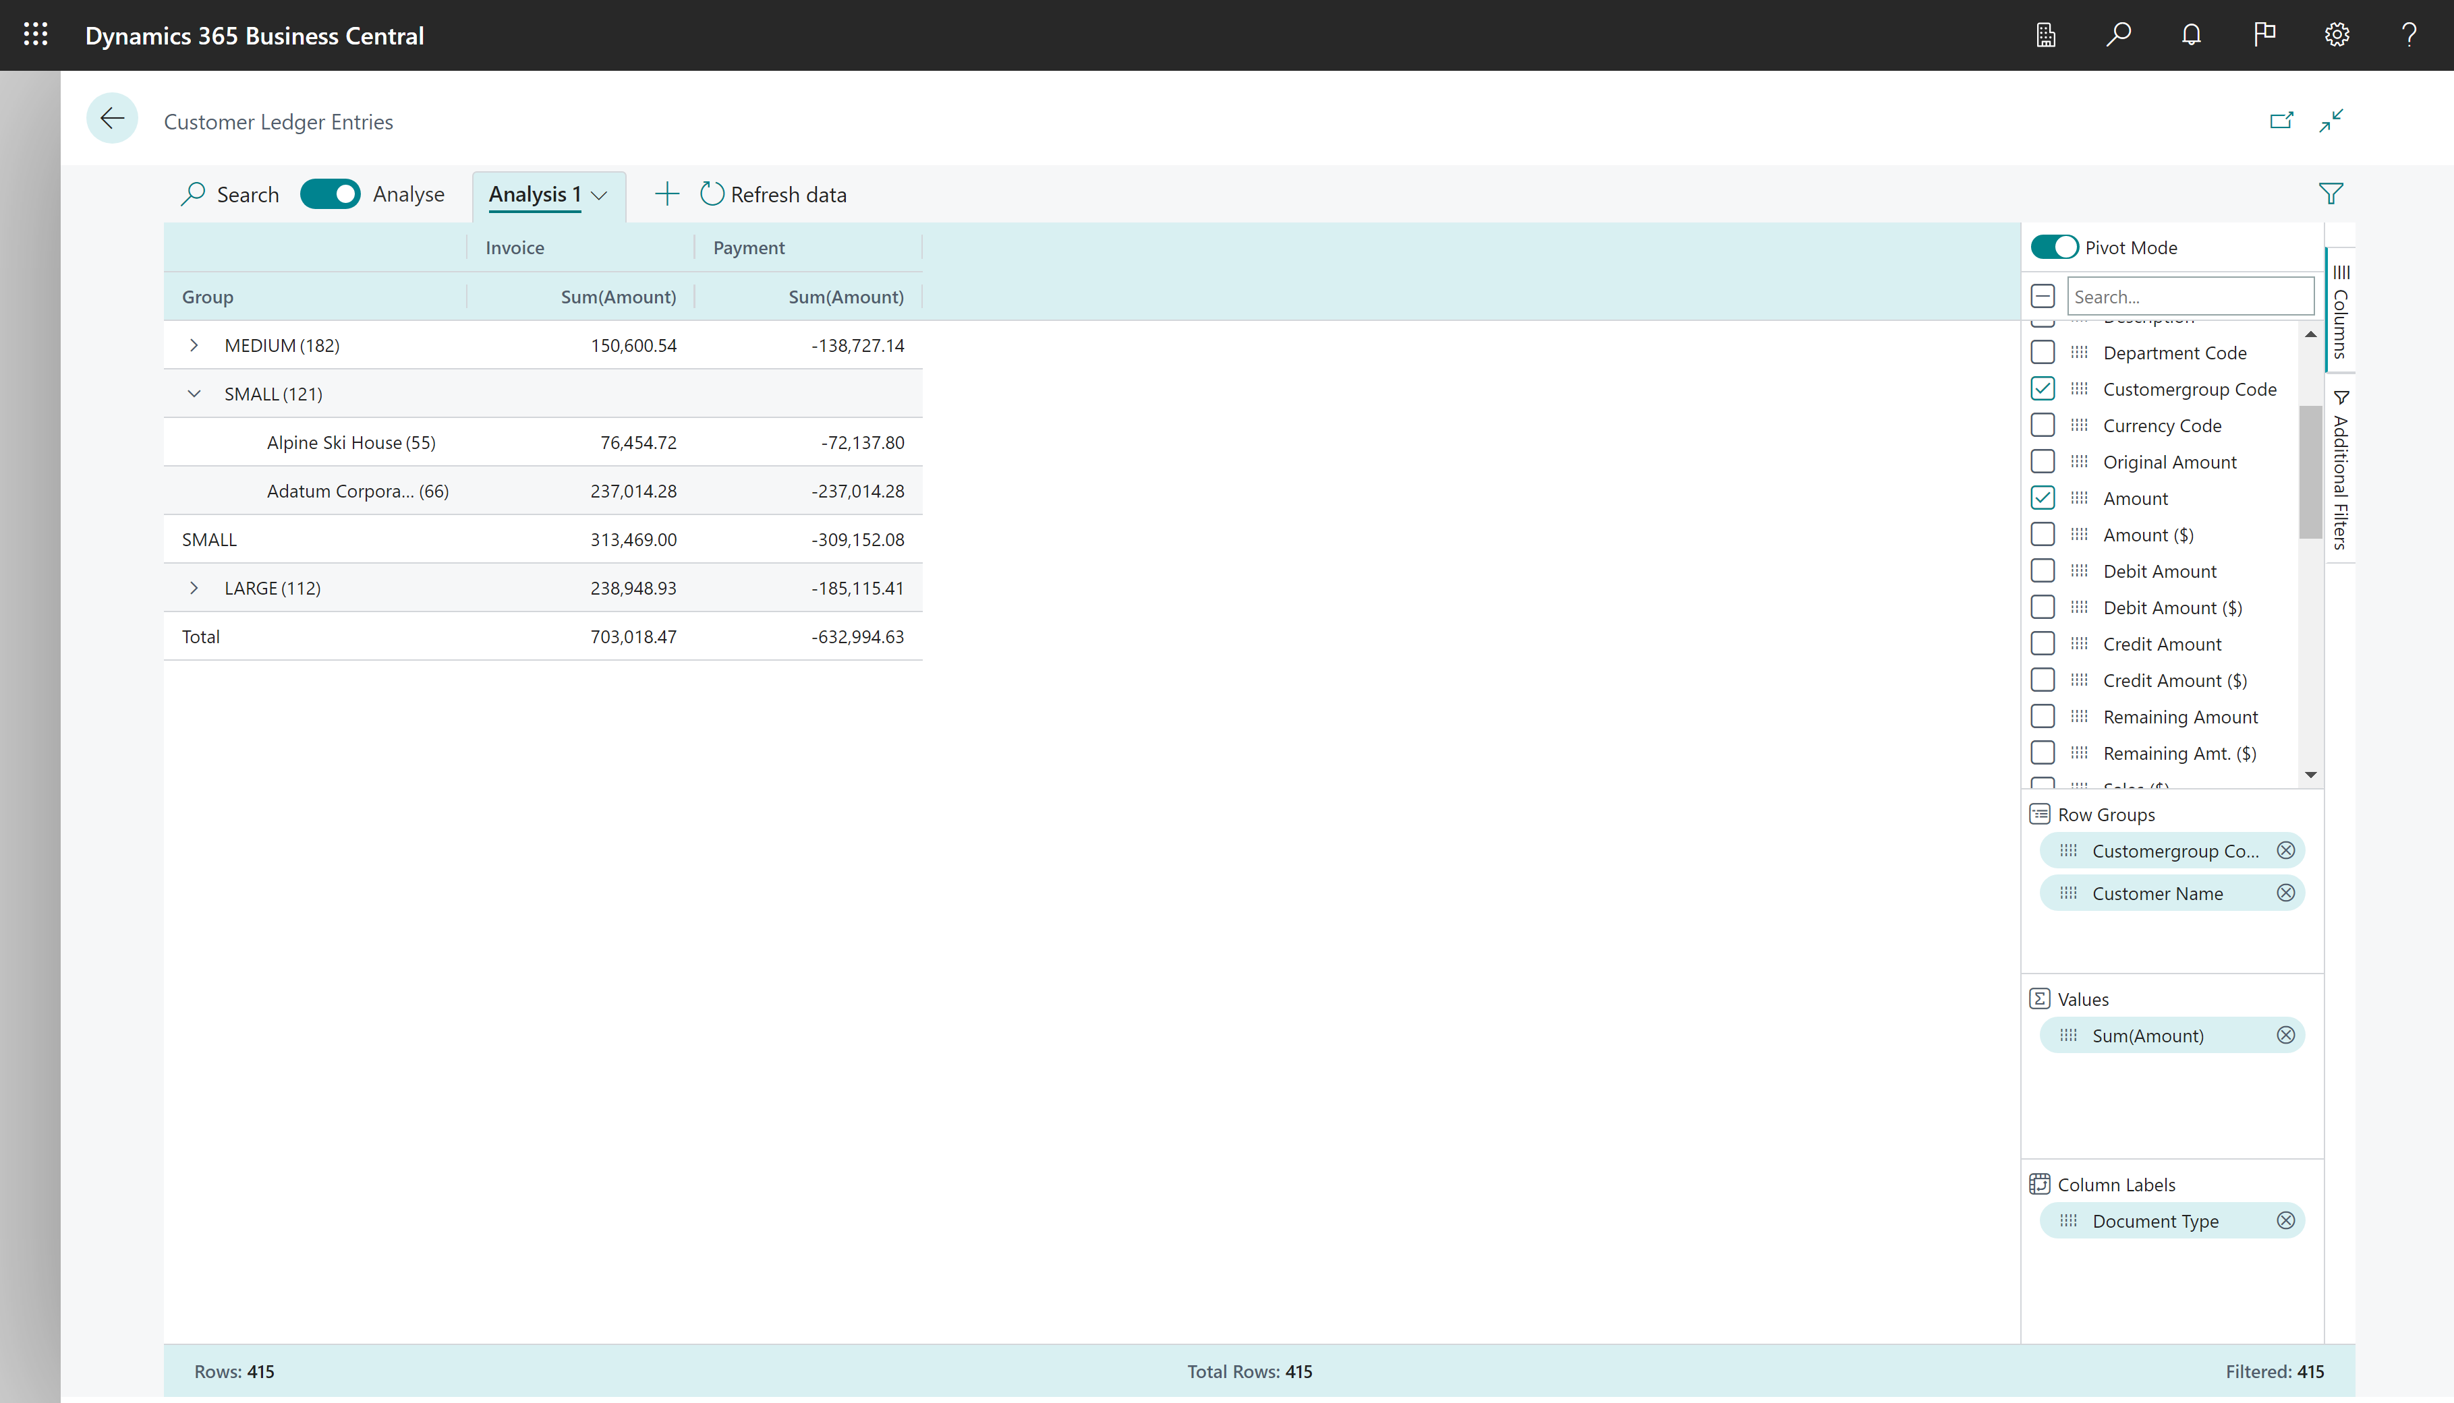
Pivot data by Row Groups and Column Labels

Slide 14
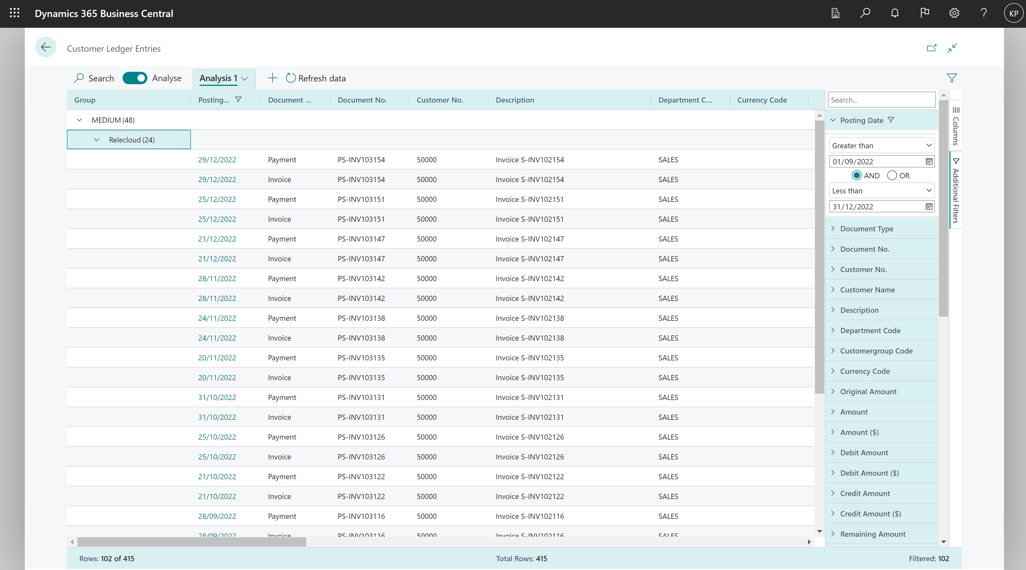
Set additional filters (local to the active tab)

Slide 15
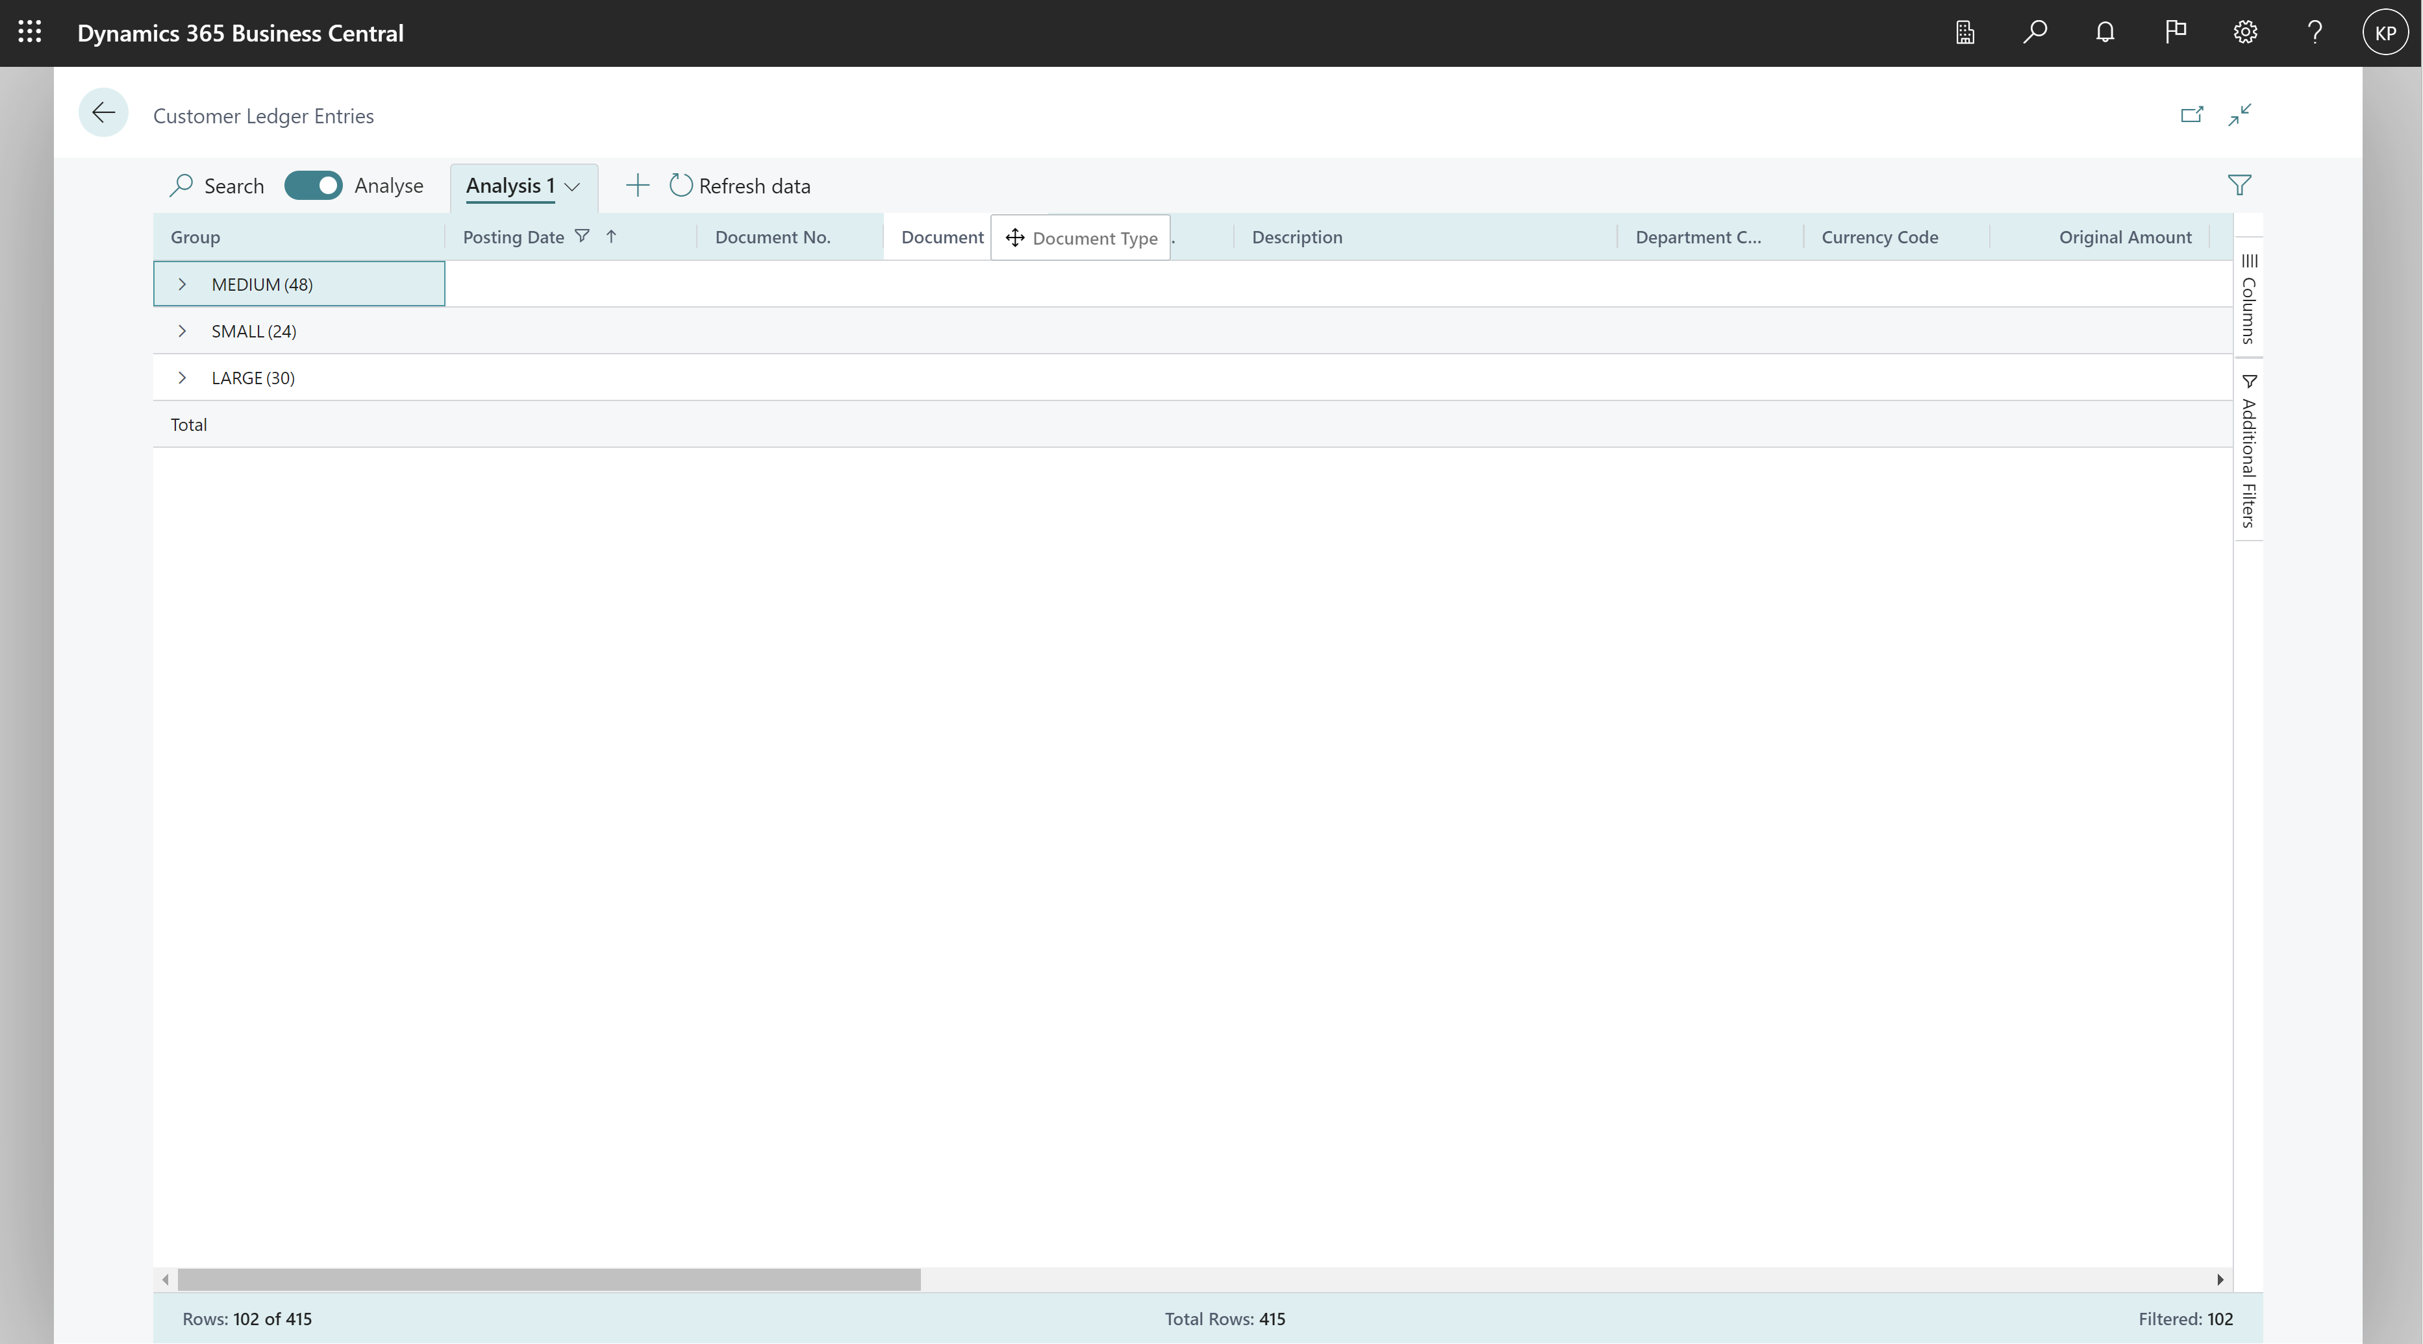
Drag and drop columns

Slide 16
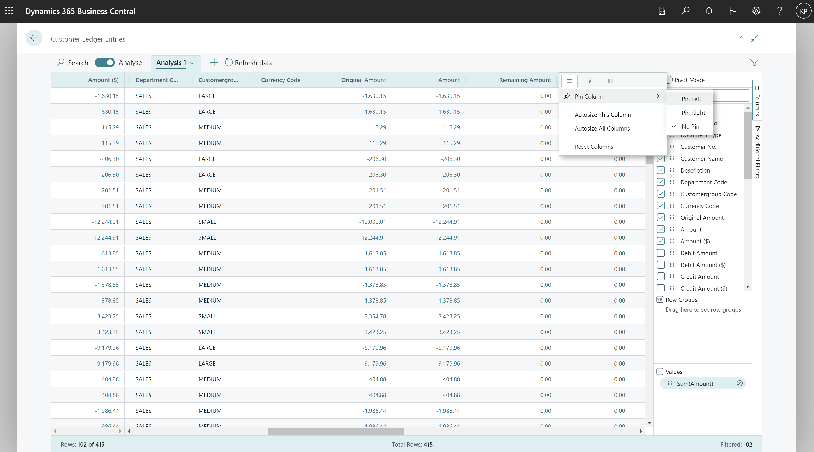
Pin columns (to left or right)

Slide 17
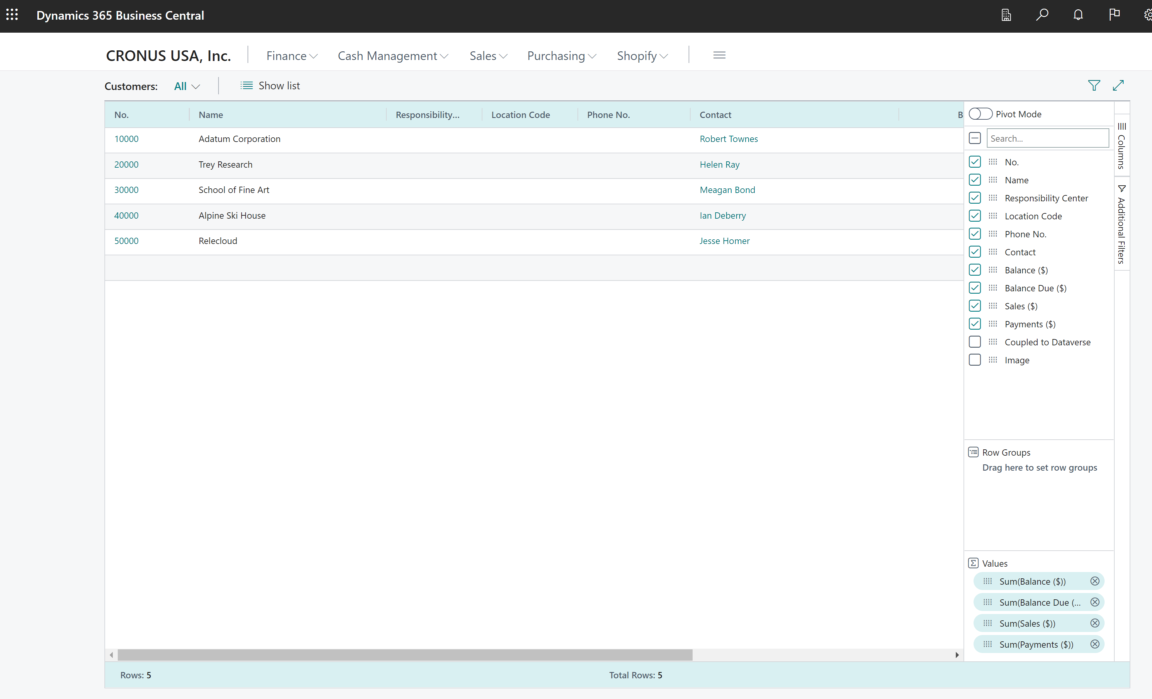
Peek to details or open card

Slide 18
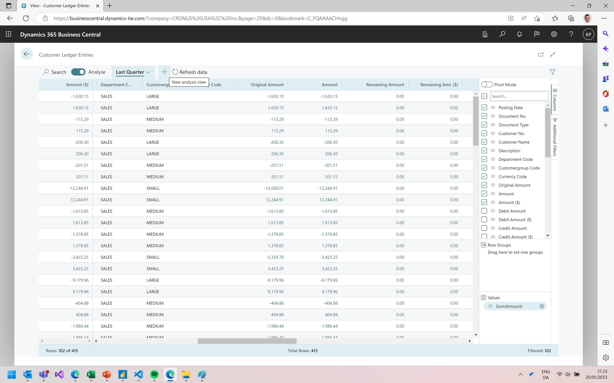
Add new tabs

Slide 19
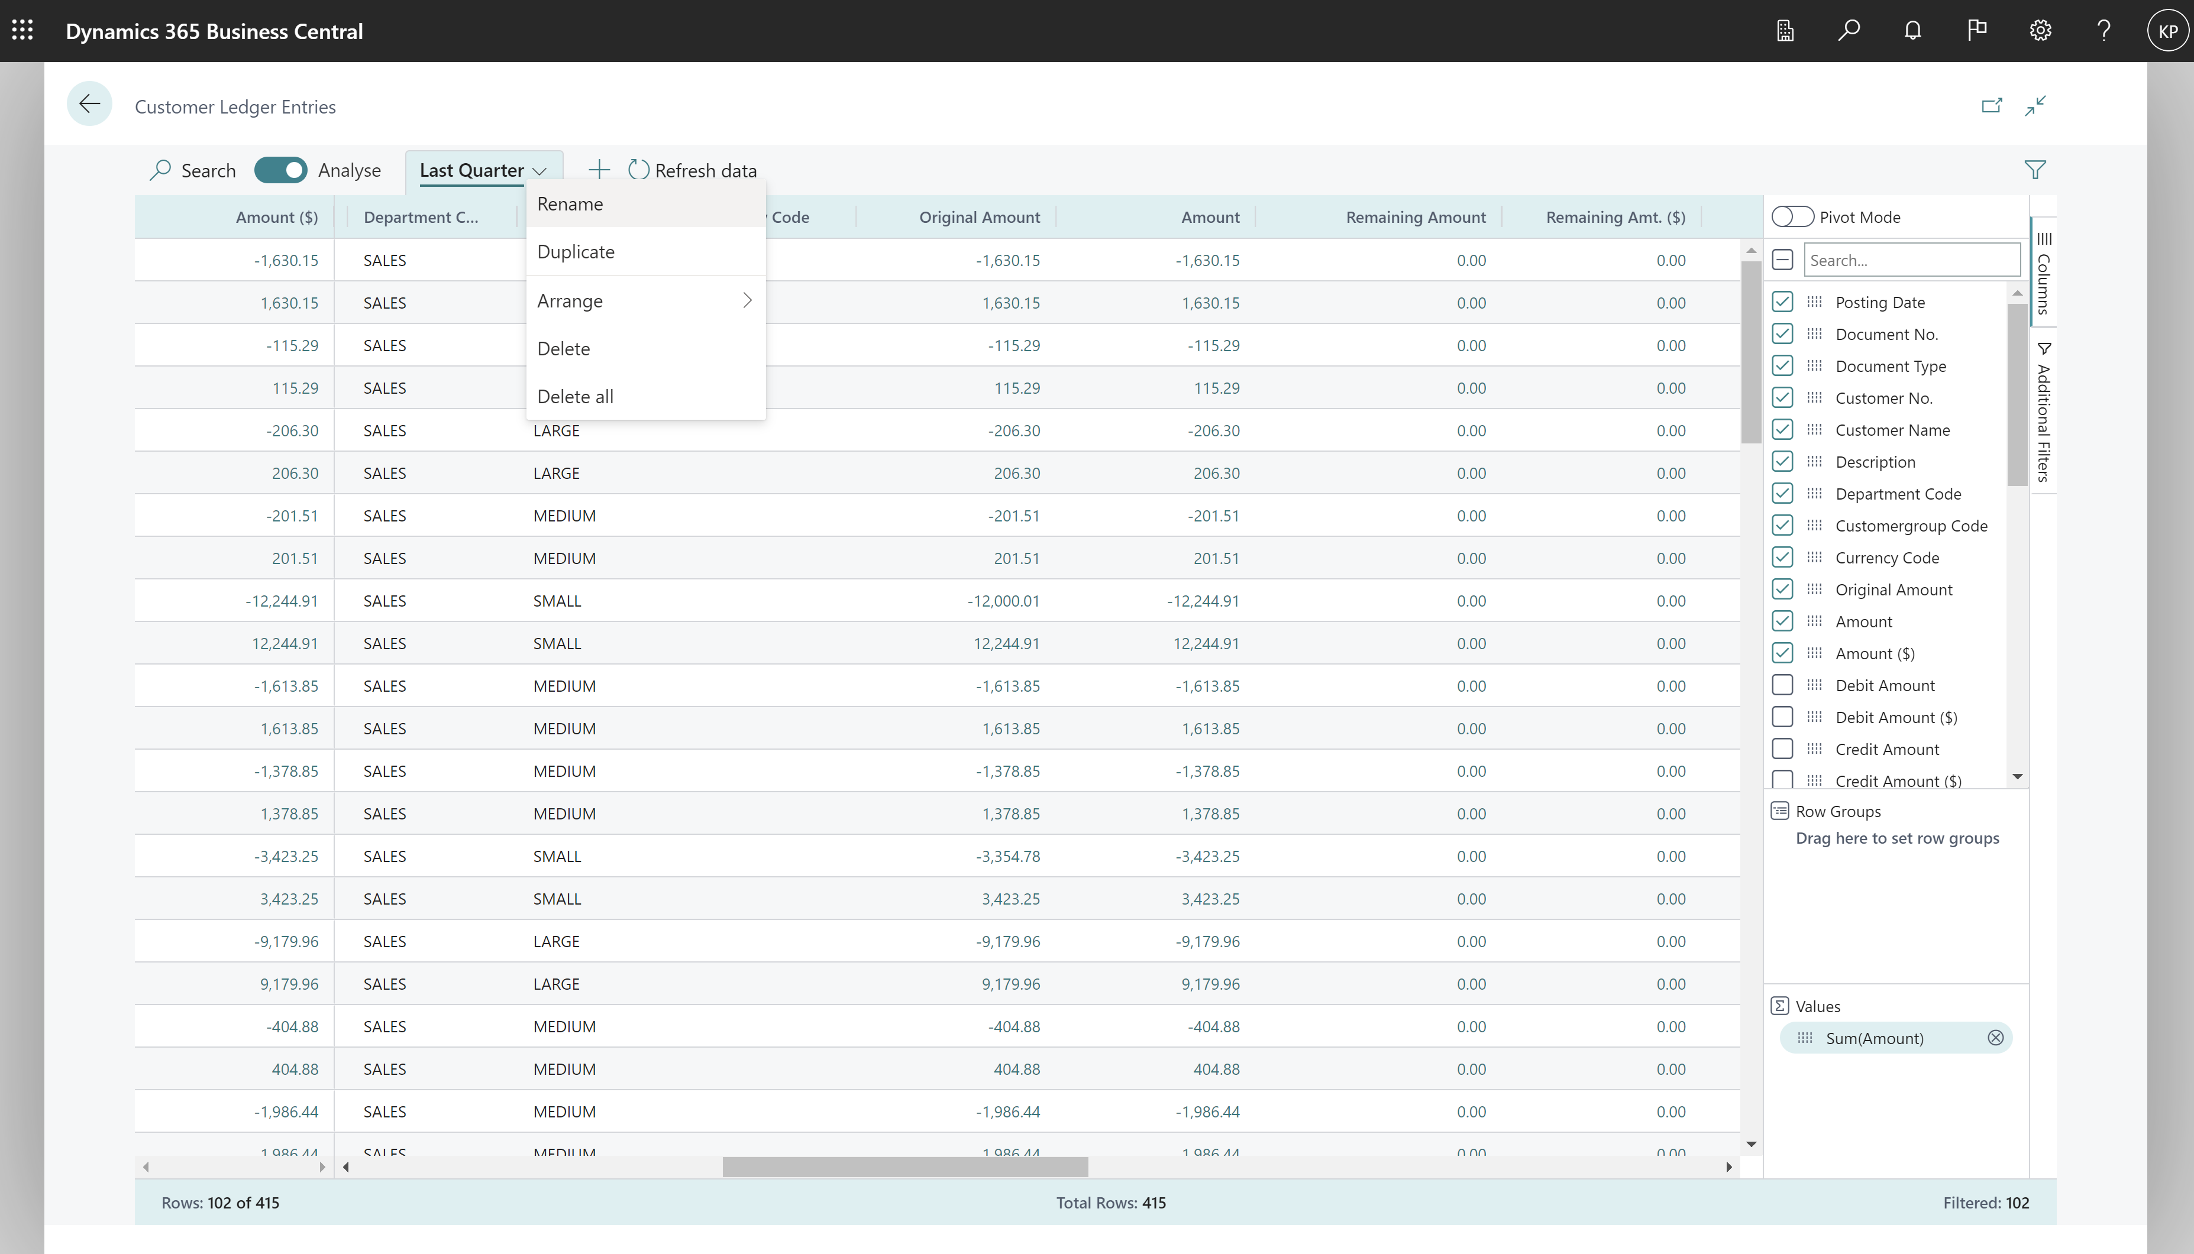
Rename (or copy or delete) tabs

Slide 20
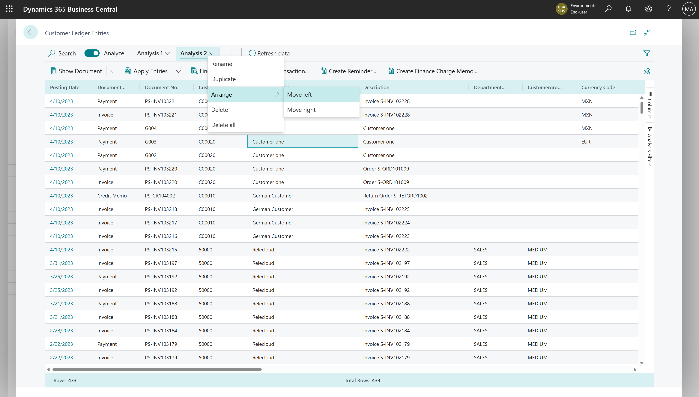
Arrange tabs

Slide 21
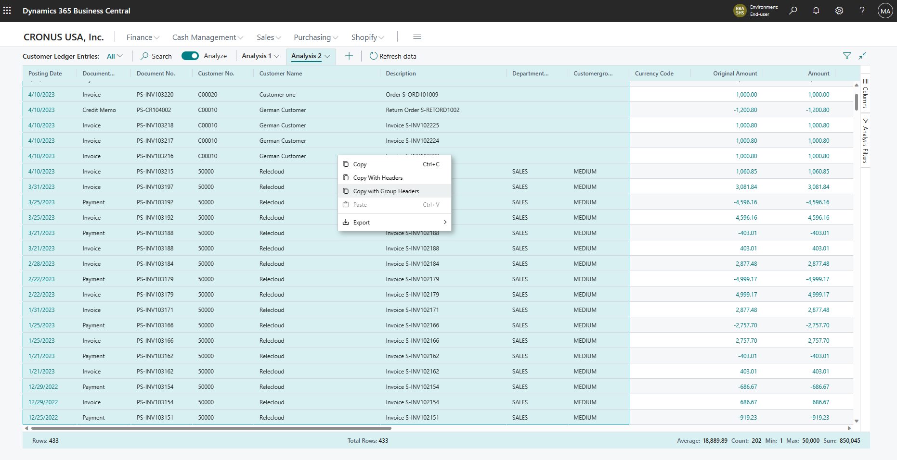
Mark data and copy (right-click on the data area)

Slide 22
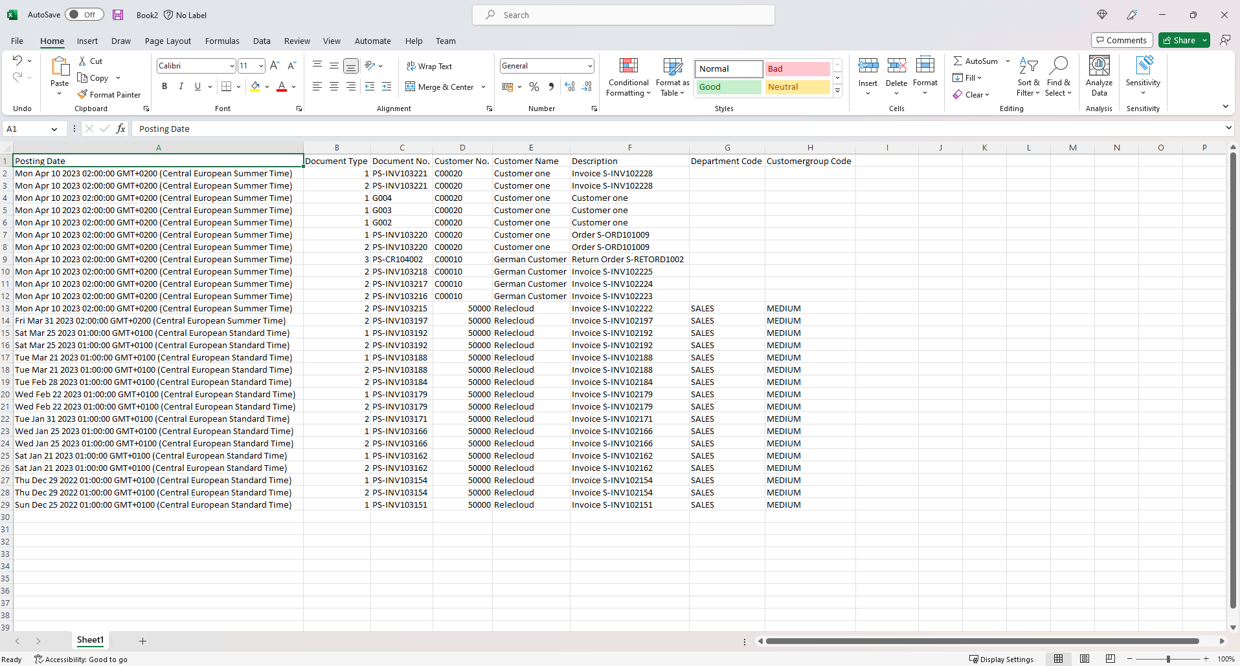
Mark data and copy (copy directly to Excel)

Slide 23
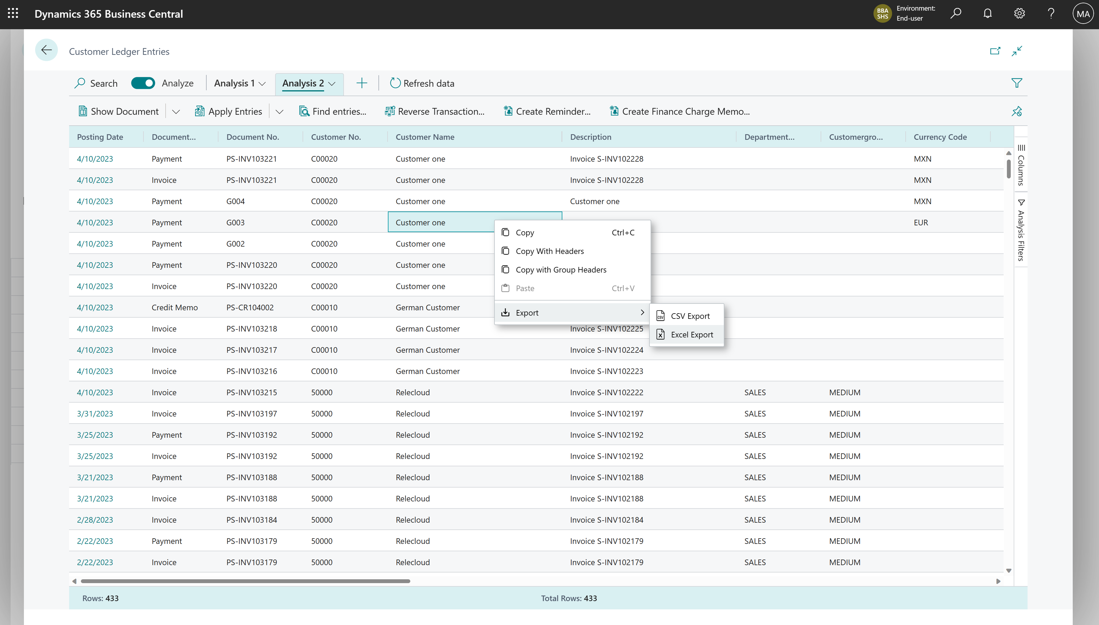
Export data (right-click on the data area)

Slide 24
Excited? We are!
Coming in public preview
Business Central
2023 release wave 1

